Slide 1

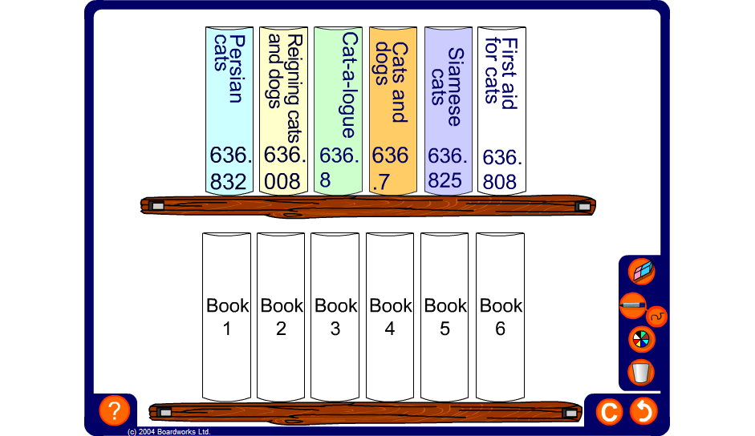


Dewey Decimal Classification System
Notes:
Practice the method for ordering decimals by completing the following activity:
Claire has been doing a project on cats and returns her books to the library. Help Mrs Hooper the librarian to put the books in the correct order using the Dewey Decimal Classification System.
In the 1870s Melvil Dewey invented a system of classifying library books on different subjects to make them easy to find. Each code has a three-digit whole number followed by a decimal part. Books are stored in DDC numerical order in libraries all over the world.
You can find science books in the range 500 – 599.999; and within that maths books are usually filed beginning 510. Books about pets have numbers beginning 636. Books about dogs start with 636.7 and books about cats start with 636.8.

